Slide 1

Week 2
JINGYA LI

Slide 2


1
Lead-in
2
Group Presentation
CONTENTS
3
Reading Text A
4
Exercises

Slide 3

Ubuntu (Para. 1)
A concept originated from the southern African region
Literal meaning “humanness”, “humanity towards others”
In a philosophical sense: “in a universal bond of sharing that connects all humanity”

Slide 4
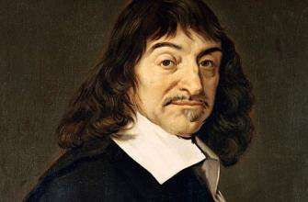

René Descartes (Para. 3)
A creative mathematician
A natural scientist or “natural philosopher”
A metaphysician

Slide 5
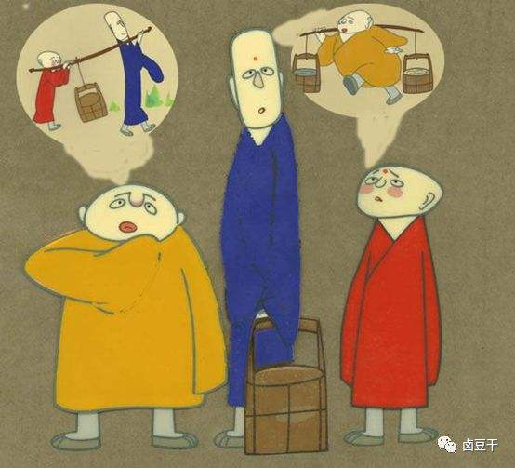
Bystander effect (Para. 6)
A situation where the more people present, the less likely they are to help people in need.

Slide 6
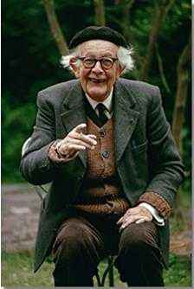
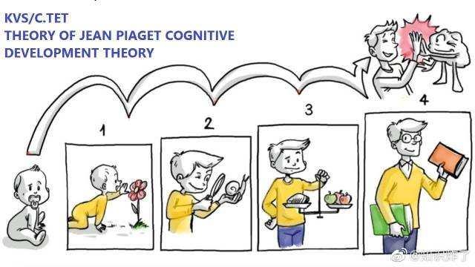
Cognitive development: Piaget (Para. 10)
The nature and development of human intelligence.
Focus: the nature of knowledge itself and how it is gradually acquired, constructed, and used.

Slide 7

Lead-in Question
What is your opinion of the quotation “I think, therefore I am”?
What is the focus of this sentence?
What process does this sentence emphasize?
What is the most important thing in human development?
How do other people affect your self-perception?
In what conditions, other people may affect your self-perception?
E.g. fail the exam?

Slide 8

“A person is a person through other persons.” --Descartes

Slide 9

Group Presentation

Slide 10
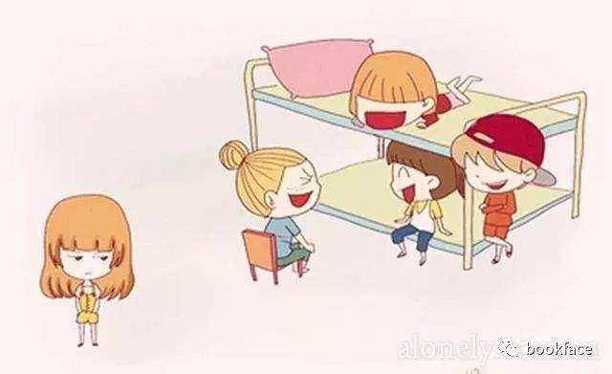
Theme of Text A
Analysis of two contrasting philosophical system on ”selfhood”
Descartes’ view:
“I think, therefore I am”
A human being is a self-sufficient creature
Human being is detached from the external world
Ubuntu philosophy:
Human existence depends upon interacting with other human beings and the outside world.
vs

Slide 11
Organization of Text A
Section 1 (Paras. 1-2): According to the Ubuntu philosophy, people acquire “selfhood” through others.
Section 2 (Paras. 3-4): Descartes held a disconcerting notion on “selfhood” and he believed in the self-sufficiency of human existence.
Section 3 (Paras. 5-7): Some researchers, influenced by this Cartesian philosophy agree that selfhood can be detached from the social context.
Section 4 (Paras. 8-12): The author discussed if the two conflicting views can be reconciled and reiterates his view that humans acquire selfhood via others.

Slide 12
Key Sentences
Even my most private and personal reflections are entangled with the perspectives and voices of different people, be it those who agree with me, those who criticize, or those who praise me. (Para. 2)
即使是我最私密、最个人的思绪，也与不同人的观点和声音纠缠在一起，无论是那些赞同我的人还是那些批评我的人，抑或是那些赞美我的人。
reflections: thoughts
are entangled with: connect to; influence
be it: including

Slide 13
Key Sentences
But even then, the investigation often presumes that a collective of Cartesian subjects are the real focus of the enquiry, not selves that co-evolve with others over time. (Para. 6)
但即便如此，其调查也常常做出这样的假设：探究的真正焦点是笛卡尔式议题的集合，而非随时间推移与其他人共同进化的自我。
presumes: assumes
collective: combination
the real focus: mainly focus on
co-evolve: develop together

Slide 14
Key Sentences
Genovese’s murder had to be seen against a backdrop in which violence against women was not taken seriously, Cherry said, and in which people were reluctant to step into what might have been a domestic dispute. (Para. 7)
谢里认为，吉诺维斯谋杀案反映了当时的社会并不关注女性遭受的暴力困扰，人民也不愿介入一桩可能是家庭纠纷的暴力袭击中。
had to be seen against: seemed to
backdrop: background
were reluctant to: were unwilling to
step into what might have been: involve in

Slide 15
Key Sentences
Think of that luminous moment when a poet captures something you’d felt but had never articulated; or when you’d struggled to summarize your thoughts, but they crystallized in conversation with a friend.
想一想那些醍醐灌顶的时刻：诗人捕捉到你所感受到的却从未表达出来的东西；或者在与朋友交谈时你灵光一现，信口而出你曾经难以总结、难以表达的一些想法。
luminous: glorious
captures: catch, produce in this sentence
articulated: found proper words to express
crystallized: became very clear

Slide 16
Key Sentences
But for the most part, scientific psychology is only too willing to adopt individualistic Cartesian assumptions that cut away the webbing that ties the self to others. (Para. 12)
但是在大多数情况下，科学意义上的心理学非常乐意采纳个人色彩浓厚的、切断了自我与他人相互联系的笛卡尔式假说。
only too willing to adopt individualistic Cartesian assumptions: very happy to accept Cartesian assumptions

Slide 17
Task 1
purport
wipe away
contextual
contour
solitary
scaffolding
axiomatic
inscribed

Slide 18
Task 2
C

Slide 19
The sentence pattern to express other people’s opinions
Who: the surname(s) of other researchers
Does: reporting verbs (e.g. believe, purport)
What: that + clause
e.g. Descartes believed that there was a trade-off between certainty and a kind of social, worldly richness.

Slide 20
Game: What is Descartes’ cognitive psychology?
Choose 4 words that belong to cognition
Group discussion (3 mins)
Cognition mainly includes:
Perception
Interaction
Memory
Experience
Procedures
Contextualization
Attention
Relationship
Cognitive psychology is a scientific study of those behaviors
Notes:
Draw lots for each idea
Each group chooses 4 concepts
Group discussion (3 mins)

